Slide 1
Fama&French&Carhart Portfolio Analysis

Slide 2
Table of contents
01
02
Cross-Sectional Analysis
03
Descriptive Statistics
Regression Analysis

Slide 3
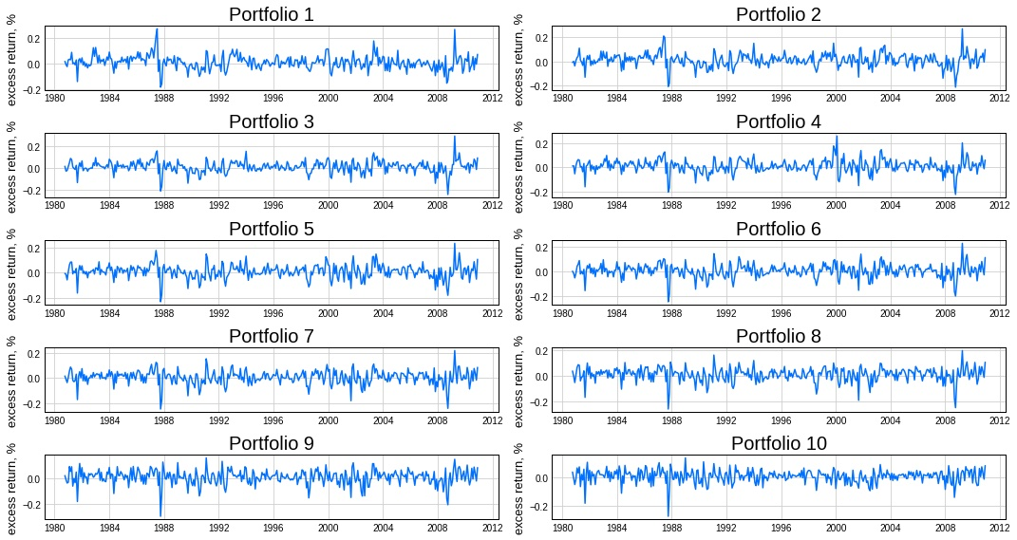
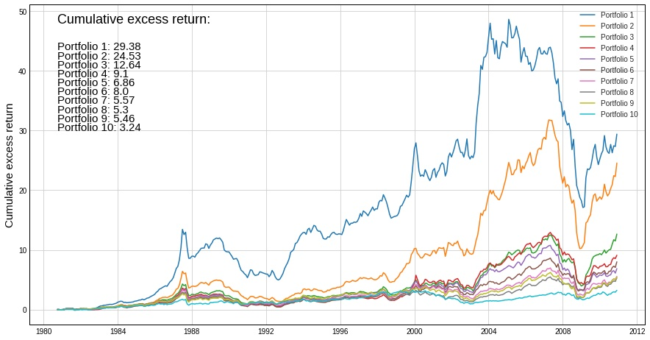
Descriptive Statistics
Cumulative excess returns formula:
$$\left(1+R_{1}\right)\left(1+R_{2}\right)…\left(1+R_{n}\right)−1$$

Slide 4
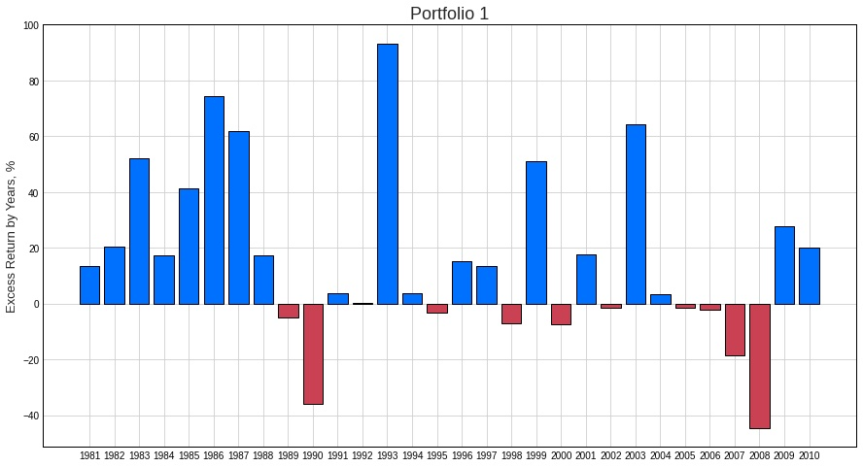
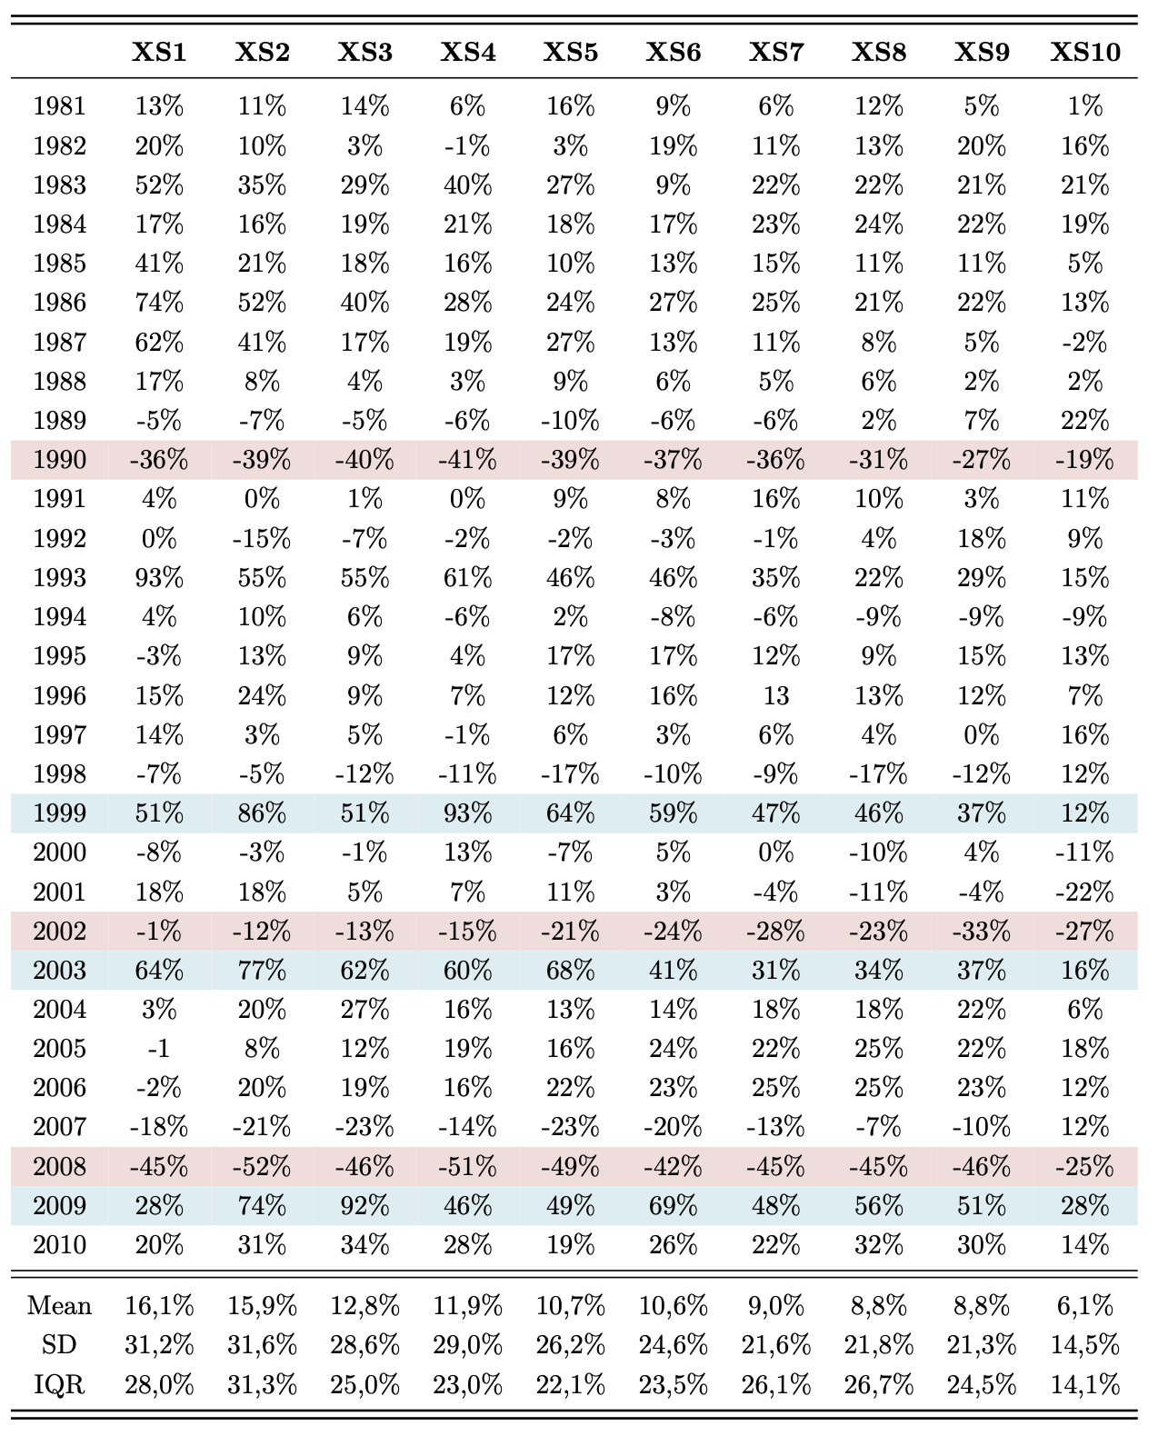
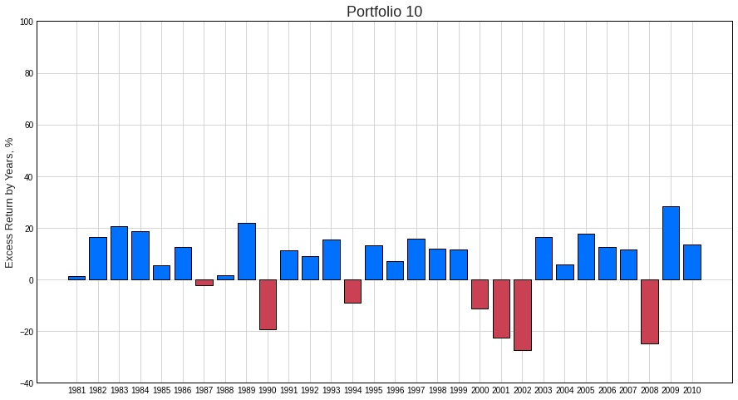
Descriptive Statistics
Excess returns of every portfolio by year

Slide 5
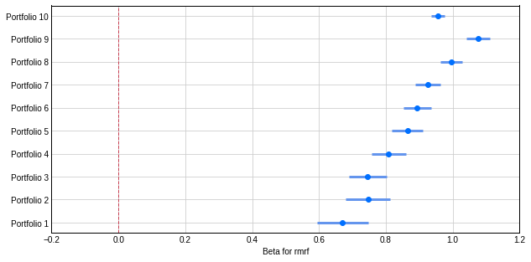
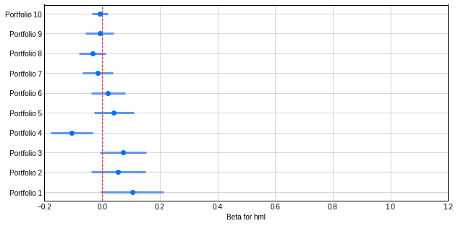
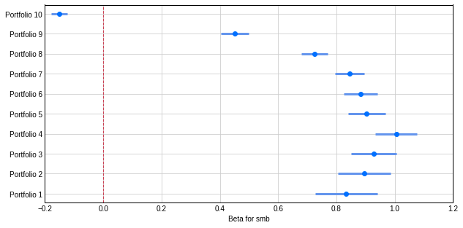
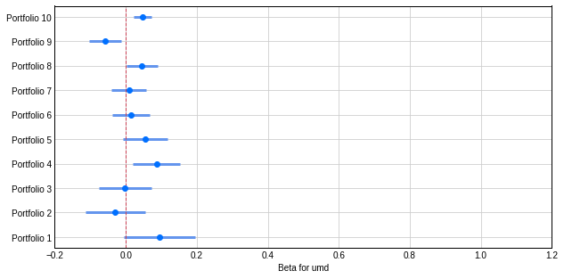
Regression Analysis
$$R_{i }= R_{f}+β_{1}RMRF+β_{2}HML+β_{3}SMB+β_{4}UMD+ε_{i}$$
$$RMRF$$
$$HML$$
$$SMB$$
$$UMD$$

Slide 6
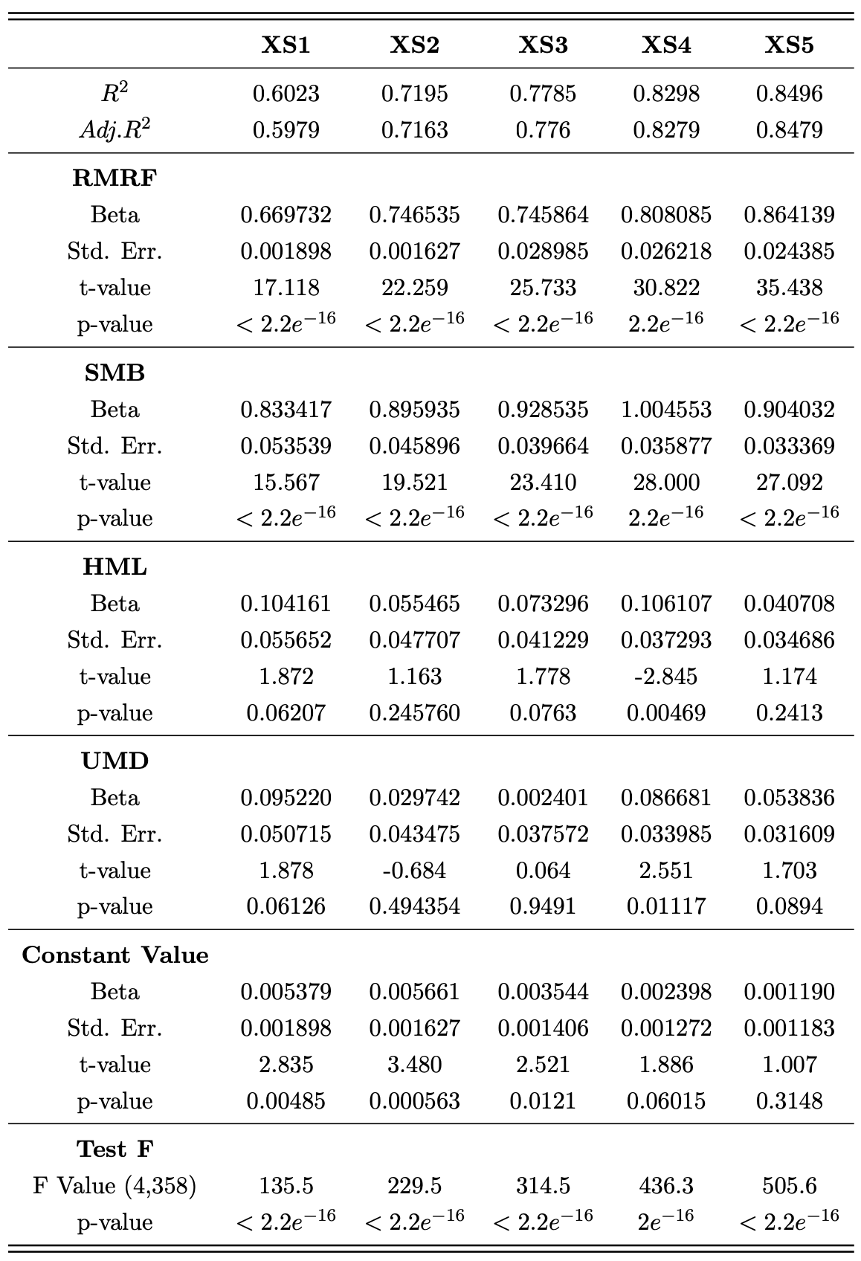
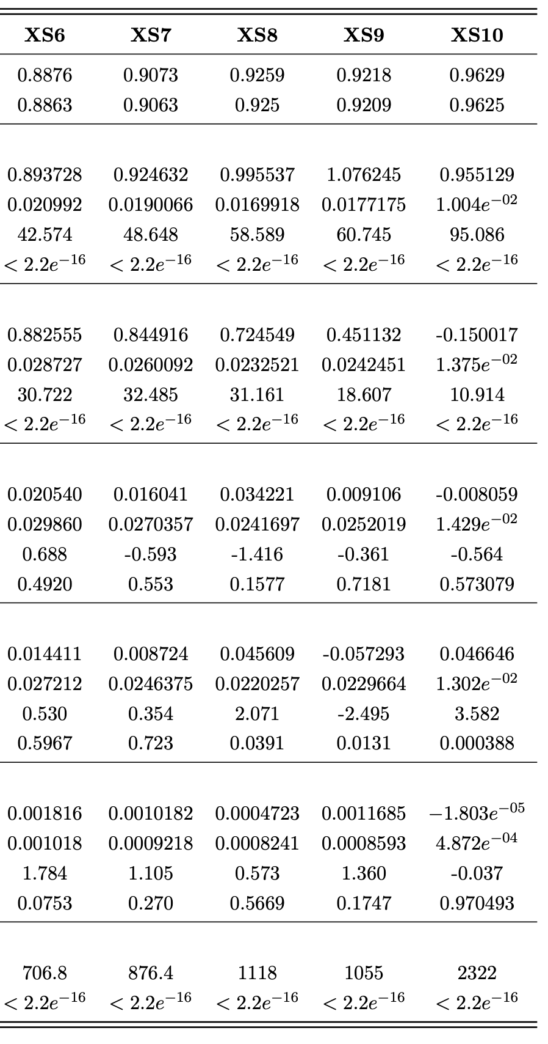
Regression Analysis
Summary statistics of regression models

Slide 7
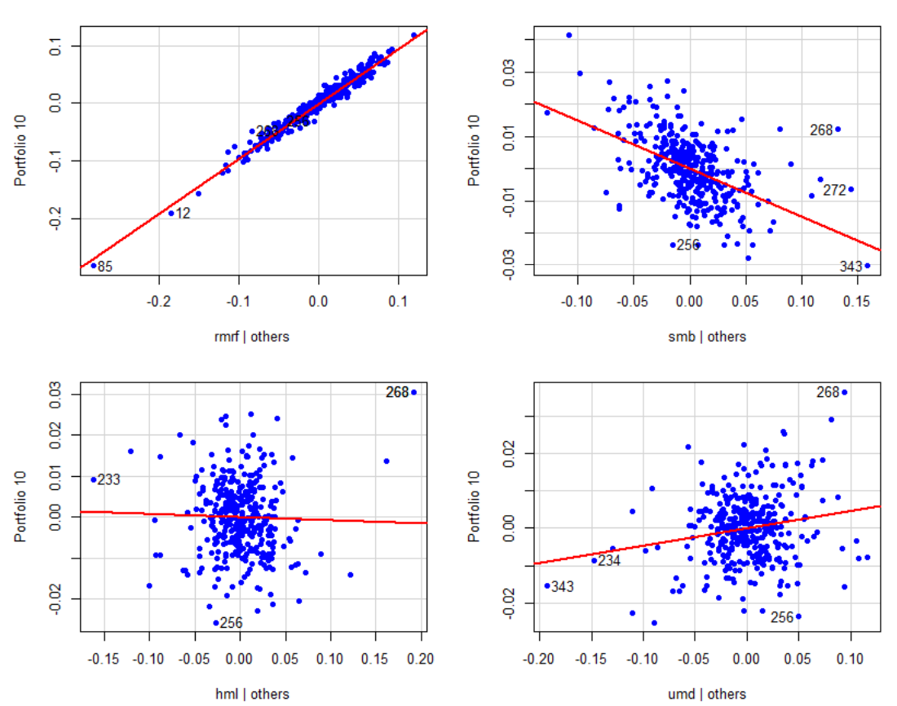
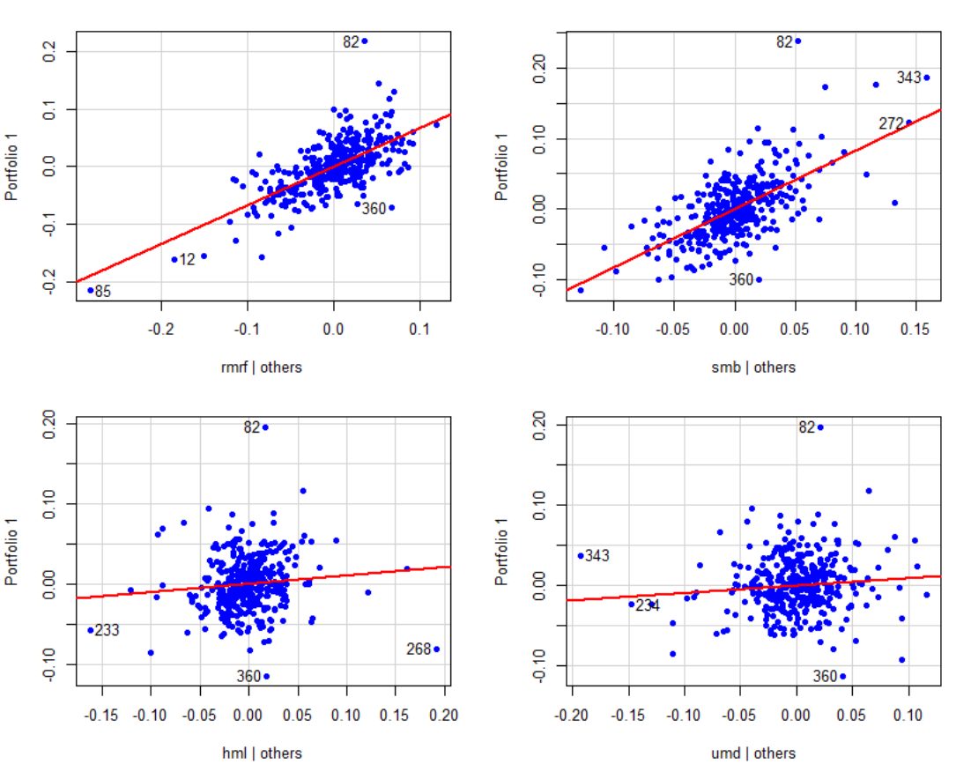
Regression Analysis
Added-Variable Plot for portfolio 1
Added-Variable Plot for portfolio 10

Slide 8
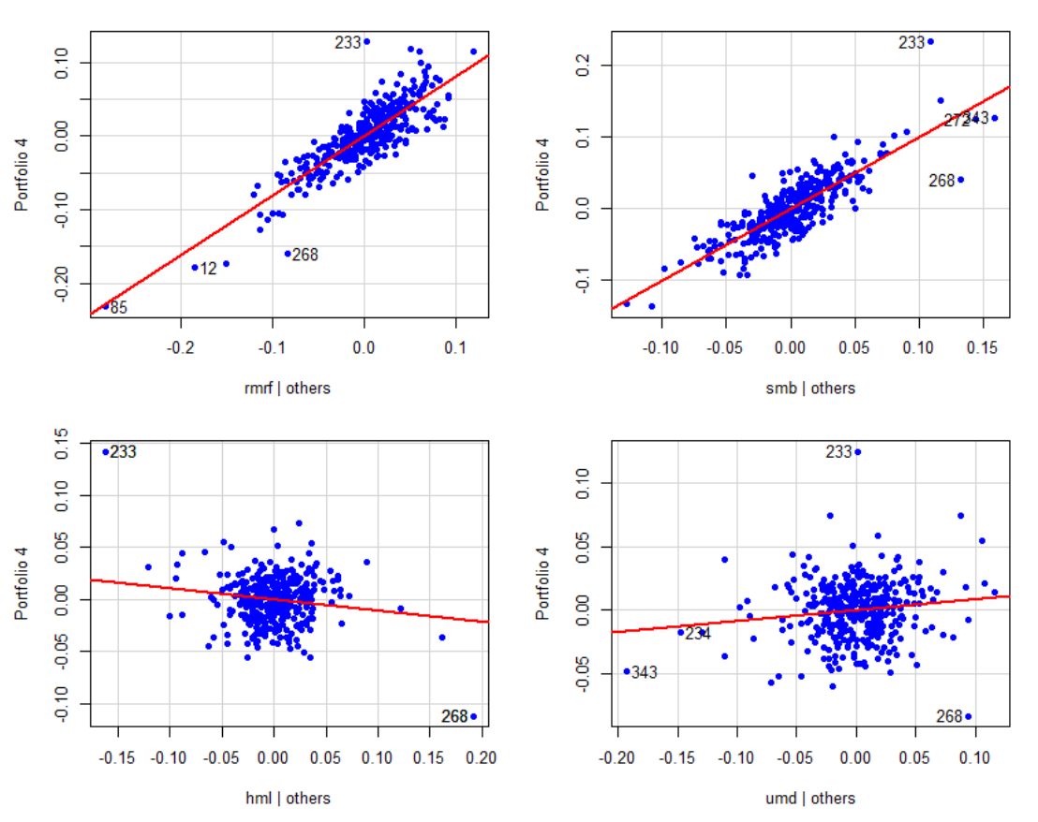
Regression Analysis
Portfolio 4 model
Added-Variable Plot for portfolio 4

Slide 9
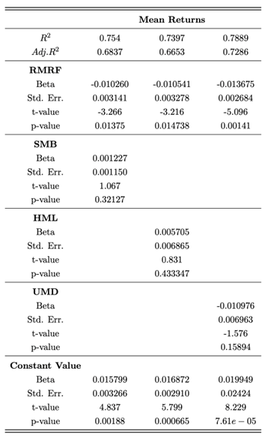
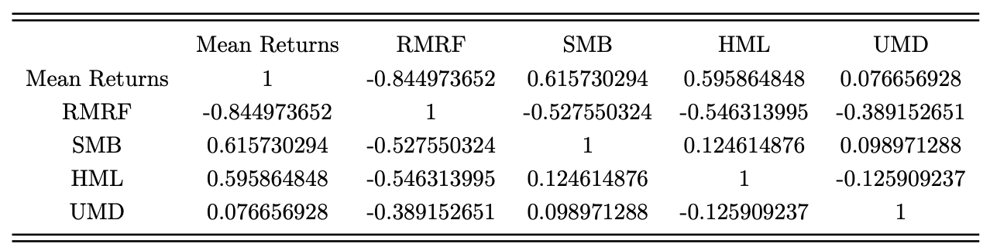
Cross-Sectional Analysis
Cross-sectional correlation matrix
and summary statistics of regression models

Slide 10
Thanks for your attention!

